Slide 1
CS 4530: Fundamentals of Software Engineering
Module 12: Designing Tests for Large Systems
Jonathan Bell, Adeel Bhutta, Mitch Wand
Khoury College of Computer Sciences
© 2022 Released under the CC BY-SA license

Slide 2
Learning Objectives for this Lesson
By the end of this lesson, you should be able to:
  Explain why you might need a "test double“ in your testing
  Understand how and when to apply different kinds of test “doubles” such as “mocks and spies”

Slide 3
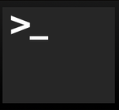

Testing Scopes Larger than Units
Integration
Unit
Mork
1 class of one program running on a web server
1 process running on a web server
Notes:
So far, our focus has been on writing on unit tests, which focus on a single module or class. To test bigger systems, we may need to create bigger tests, such as integration tests. Many bugs may be observable only when multiple components interact (often as a result of one making an incorrect assumption about the others’ behavior).
What do integration tests include? If we’re testing an entire application, then that surely is an integration test. If we are working at any reasonable scale, it’s likely that we will want to write tests for things bigger than a single application that is just one process running on one server.

Slide 4

“Integration” Tests Might be Larger
Integration
Unit
Mork
1 class of one program running on a web server
1 web server in a cluster of 100,000
1 process running on a web server
Notes:
For instance, our idea of our server software might actually consist of multiple processes running in coordination on a single server, which itself might be in a cluster of 100’s of thousands of servers.

Slide 5
Some Tests are Enormous
Integration
Unit
Mork
1 class of one program running on a web server
1 Google product in the entire Google ecosystem
1 web server in a cluster of 100,000
1 process running on a web server
Notes:
Or, maybe our focus is on testing the end-to-end behavior of an entire product, which is composed of many classes running in many processes on many servers. As you can see, the scope of integration tests can grow enormously.

Slide 6
Classify Tests by Size and Scope
“Large”
Integration
Unit
“Medium”
“Small”
Mork
1 class of one program running on a web server
1 Google product in the entire Google ecosystem
1 web server in a cluster of 100,000
1 process running on a web server
“Software Engineering at Google: Lessons Learned from Programming Over Time,” Wright, Winters and Manshreck, 2020 (O’Reilly)
Notes:
The lens that we will use to discuss testing strategies for large systems is “test size,” a strategy used within Google: classify tests into a size and encourage engineers to always write the smallest possible test for a given piece of functionality.
Test size is based on what it is allowed to do, and how many resources it consumes.
small tests run in a single process, medium tests run on a single machine, and large tests run wherever they want.
Small tests, regardless of the scope, are almost always faster and more reliable than tests that involve more infrastructure or consume more resources. More can go wrong if you have to spin up entire VMs in the middle of your test.

Slide 7
How big is my test?
Small: run in a single thread, can’t sleep, perform I/O or making blocking calls
Medium: run on single computer, can use processes/threads, perform I/O, but only contact localhost
Large: Everything else
“Software Engineering at Google: Lessons Learned from Programming Over Time,” Wright, Winters and Manshreck, 2020 (O’Reilly)
Notes:
Small tests are structured to be fastest, most reliable. This becomes important if you want to run your tests a lot, like if you have ten thousand developers running tests 24/7. Similar to traditional unit/
Medium can do lots of stuff, but note importance of not connecting to other servers. This is so your entire test is self contained.
Large is everything else. These can be slowest to run and most fragile. Imagine you are testing connecting to a remote server, and sometimes it’s slow, or the canonical distributed systems example of an intern tripping over a cable. So, speaking of fragile.

Slide 8
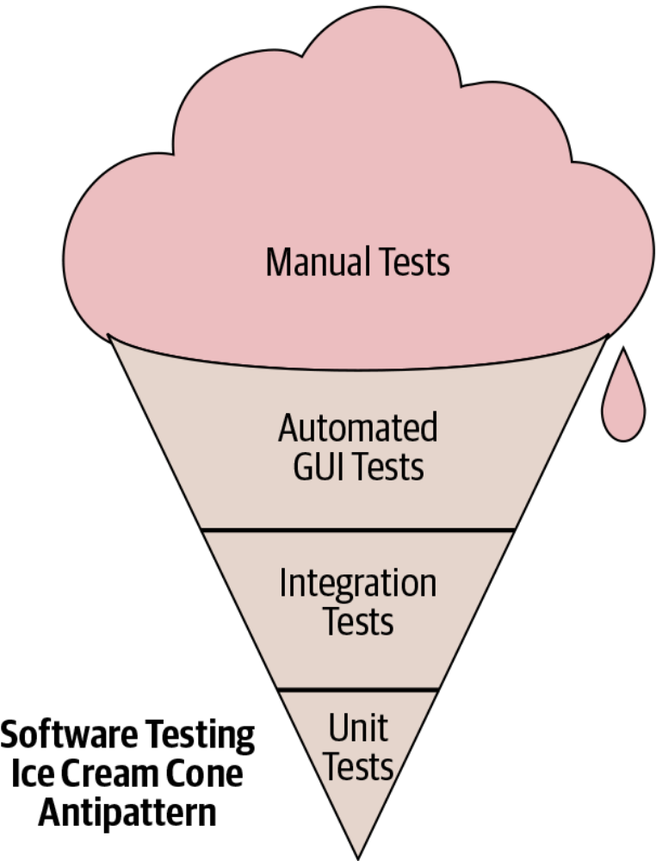
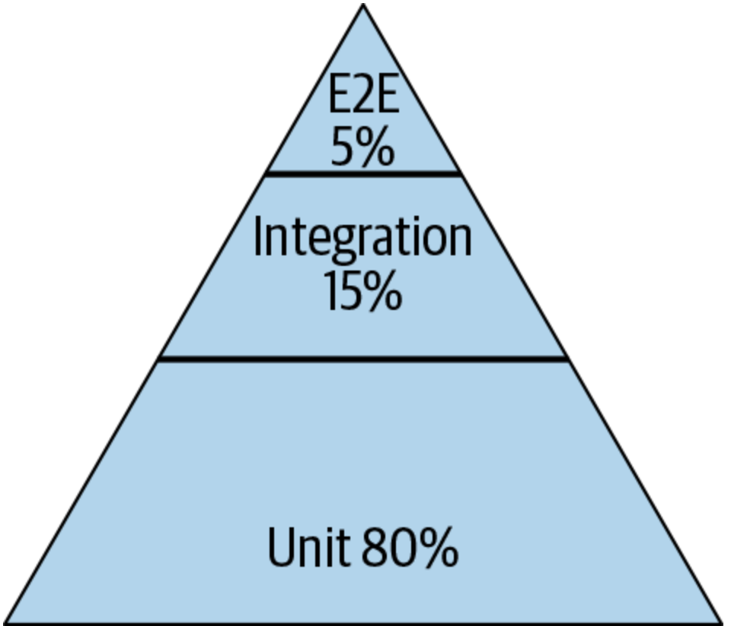
Testing Distribution (How much of each kind of testing we should do?)
Pyramid
Test Pattern
From SoftEng @ Google Chapter 11
  https://learning.oreilly.com/library/view/software-engineering-at/9781492082781/ch11.html#testing_overview
Notes:
Typically we talk about this ice cream cone where we have a lot of a lot of manual tests, and then some automatic automated tests specifically related to GUI and then some integration tests and unit tests. The book that we mentioned earlier, software engineering at Google, recommends a different paradigm. It recommends that about 80% of your testing should be focused on unit testing and then about 15% on integration testing and then about 5% on end to end testing (what is known as system level testing).

Slide 9
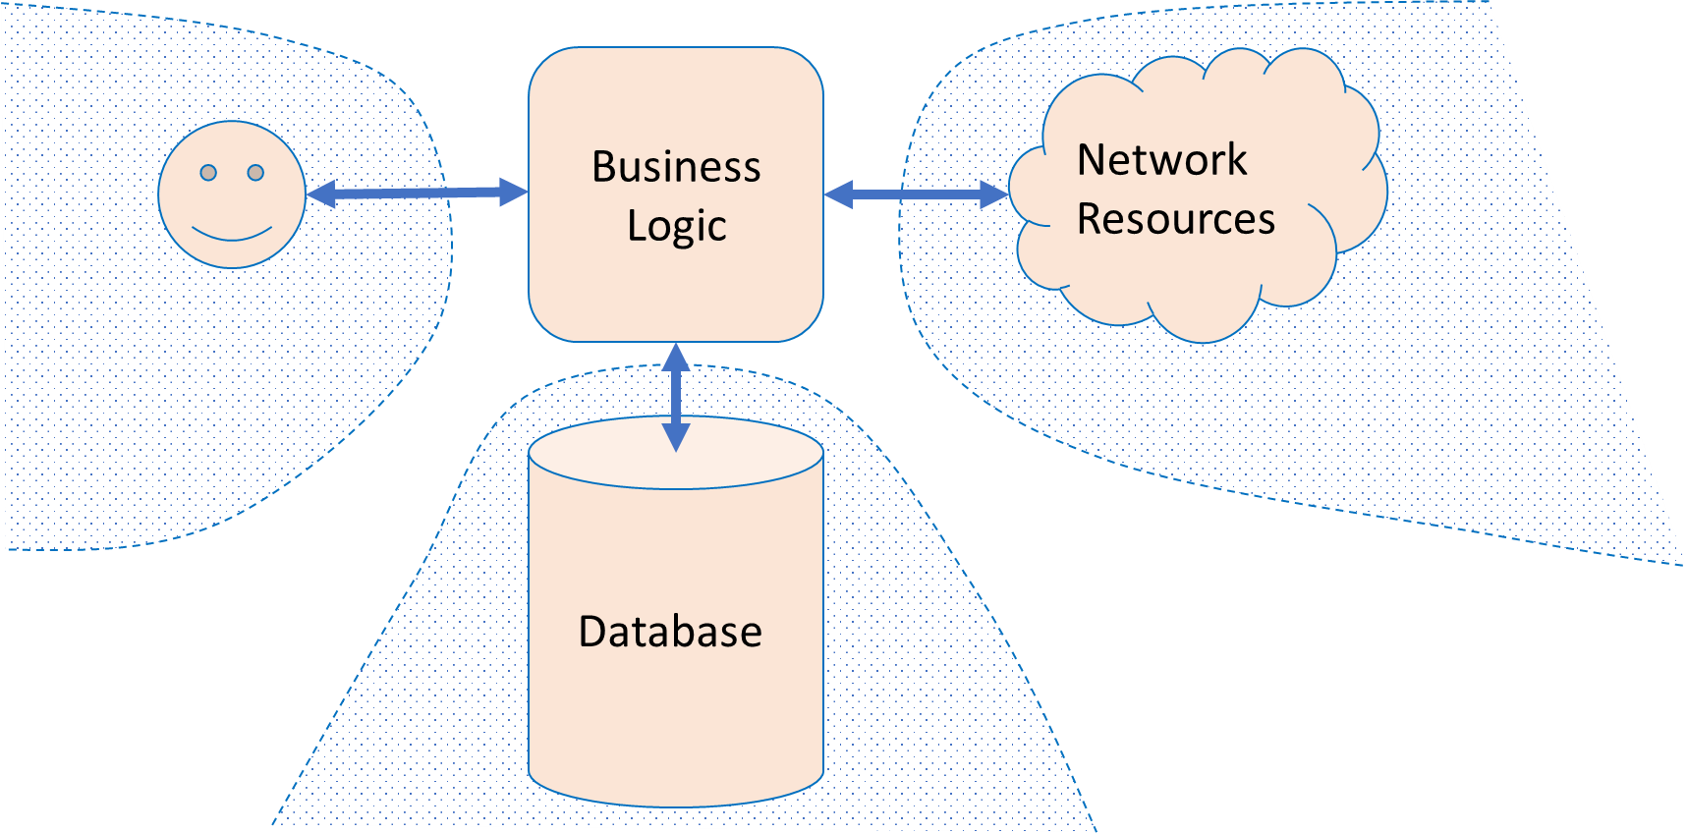
Large Systems are Hard to Test
Database component
  Contents may need to reflect/simulate real-world;
  Data may be expensive/proprietary/confidential.
Network connections
  ”Real” connections may be slow/flaky/disrupted;
  Resources may have changed since test was written.
Environment
  Interactions with OS, locale or other software.
Human actors
  Ultimately unpredictable.
Specification ambiguity
  Large systems -> many behaviors/interactions to consider
Notes:
Let’s talk about some of the complexities of larger systems
<read slide>

Slide 10
Test Doubles replace uncontrollable pieces of the environment
Business Logic
Network
Resources
Mo
Random user
Mock network
Database
Fake Database
Notes:
The overall approach to build small tests for large systems is to use a “test double”. Test doubles replace uncontrollable pieces of the environment with something that we can control.

Slide 11
What are Test Doubles?
Test Double
Test Double
Business Logic
Network
Resources
Mo
Test Double
Random user
Mock network
Database
Fake Database
Notes:
Doubles are things that look like the real thing but they are not real.
If you are working on a system which sends an email to customer after an operation, how will you test it? Instead of sending a real email every time you test, you can use doubles (i.e., a mock mail service)
One way to say this is: you need test doubles when you code (or function) has side effects.

Slide 12
When to use Test Doubles?
To create “small” tests that are faster and less flaky
  Example: Testing a unit that processes result of an external API call; only interested in testing what happens after the external call returns
When the real thing is unavailable
  Example: Integrating with external vendors
When testing for unusual or exceptional cases that are hard to make happen in practice
  Example: when external service fails in the middle of a transaction
Notes:
Test doubles are used in many situations!

Slide 13
Test Doubles Intercept Calls to Methods
Testing frameworks provide two common abstractions for doubles
  Transparently modifies programs while running to intercept calls
Spies invoke the original method, but record the parameters and call information
Mocks do not invoke the original method
  Default is to provide canned responses (Jest picks: undefined)
  Also can provide a mock implementation to entirely replace the original method
Other frameworks use terms like “fake” and “stub” for variants of these; we focus on Jest’s features (spies, mocks)

Slide 14
Test Spy is a stub that remembers how the object was called
Test can check what happened earlier;
  For example: a particular method should be called
    First with parameters “foo” and 42;
    Then with parameters “quux” and -88.
A spy can be useful in conjunction with the “real” environment:
  What was sent on the network?
  How many times a problem was logged?
  What was inserted in the database?
Spy “remembers”
Notes:
Spies are stubs that also record some information based on how they were called. One form of this might be an email service that records how many messages it was sent. This is an example of spy being used with a real email service

Slide 15
Example: Test Spies in IP2
useConversationAreaOccupants should call the method addListener when rendered, and on cleanup, call removeListener with the same exact argument
Our test for this requirement uses two spies to inspect calls to these methods
beforeEach(() => {
conversationAreaController = new ConversationAreaController(nanoid(), nanoid());
addListenerSpy = jest.spyOn(conversationAreaController, 'addListener');
removeListenerSpy = jest.spyOn(conversationAreaController, 'removeListener');
});
Before each test: create a ConversationAreaController to test with the hook, spy on its addListener and removeListener methods
it('Removes its update listener when the component unmounts', () => {
const listenerAdded = getSingleListenerAdded('occupantsChange');
cleanup();
const listenerRemoved = getSingleListenerRemoved('occupantsChange');
expect(listenerAdded).toBe(listenerRemoved);
});
Test that the listener added is the exact same listener removed, getSingleListenerAdded/removed uses spy.mock.calls to find the arguments passed to addListener
Notes:
Spies let us inspect the internal state of our system, allowing us to make assertions about the method calls that occur in the system under test.
(Read example)
The point of this spy is to have much more knowledge of the internal object state in exchange for deeper coupling, which could be problematic in the future because it makes our tests more fragile.

Slide 16
Test Mock is a Double that has Scripted results
A test mock has scripted results:
  If such-and-such a method is called
    return some particular value.
A complex mock can have many scripts:
  Multiple methods;
  Different results for subsequent calls.
Useful mocking assumes we know how mocked object will be used.
Jest’s default behavior is to return “undefined”, we can modify this
Mock has “scripted answers” and is used for “behavior verification”
Notes:
Mocks are objects pre-programmed with expectations which form a specification of the calls they are expected to receive. It is used to record and verify the interaction between classes/components. A mock is known as the most powerful and flexible version of the test doubles.
The mock objects are generally used for behavior verification. The term behavior means to check the correct methods and paths that are applied to the objects.
Mocks are mostly created by using a library or a mocking framework like Mockito, JMock, and EasyMock. It is used for testing a large suite of tests where stubs are not sufficient.

Slide 17
Jest supports Mocks
Jest’s Mock API: https://jestjs.io/docs/mock-function-api
Replacing TwilioVideo with Mock
You will see more of these in IP2
const mockTwilioVideo = mockDeep<TwilioVideo>();
jest.spyOn(TwilioVideo, 'getInstance').mockReturnValue(mockTwilioVideo);
Jest Tests can be written
it('should use the coveyTownID and player ID properties when requesting a video token',
async () => {
const townName = `FriendlyNameTest-${nanoid()}`;
const townController = new CoveyTownController(townName, false);
const newPlayerSession = await townController.addPlayer(new Player(nanoid()));
expect(mockTwilioVideo.getTokenForTown).toBeCalledTimes(1);
expect(mockTwilioVideo.getTokenForTown).toBeCalledWith(townController.coveyTownID, newPlayerSession.player.id);
});
Notes:
There are three main types of module and function mocking in Jest:
jest.fn: Mock a function
jest.mock: Mock a module
jest.spyOn: Spy or mock a function
Here is a nice review:
https://medium.com/@rickhanlonii/understanding-jest-mocks-f0046c68e53c

Slide 18
Here is another Example of Mock /1
describe('conversationAreaCreateHandler', () => {
const mockCoveyTownStore = mock<CoveyTownsStore>();
const mockCoveyTownController = mock<CoveyTownController>();
beforeAll(() => {
// Set up a spy for CoveyTownsStore that will always return our mockCoveyTownsStore as the singleton instance
jest.spyOn(CoveyTownsStore, 'getInstance').mockReturnValue(mockCoveyTownStore);
});
beforeEach(() => {
// Reset all mock calls, and ensure that getControllerForTown will always return the same mock controller
mockReset(mockCoveyTownController);
mockReset(mockCoveyTownStore);
mockCoveyTownStore.getControllerForTown.mockReturnValue(mockCoveyTownController);
});
. . . .
spying on getInstance() method
Notes:
This test will spy on the getInstance method of CoveyTownsStore, always returning a mock instance. Then, whenever getControllerForTown is called, it will always return a mock CoveyTownController.

Slide 19
Here is another Example of Mock /2
. . . .
it('Checks for a valid session token before creating a conversation area', ()=>{
const coveyTownID = nanoid();
const conversationArea :ServerConversationArea = { boundingBox: { height: 1, width: 1, x:1, y:1 }, label: nanoid(), occupantsByID: [], topic: nanoid() };
const invalidSessionToken = nanoid();
// Make sure to return 'undefined' regardless of what session token is passed
mockCoveyTownController.getSessionByToken.mockReturnValueOnce(undefined);
requestHandlers.conversationAreaCreateHandler({
conversationArea,
coveyTownID,
sessionToken: invalidSessionToken,
});
expect(mockCoveyTownController.getSessionByToken).toBeCalledWith(invalidSessionToken);
expect(mockCoveyTownController.addConversationArea).not.toHaveBeenCalled();
});
});
If SessionToken is invalid, don’t call addConversationArea()
Notes:
The test checks to see that conversationAreaCreateHandler does NOT call addConversationArea if the session token is invalid, which it simulates by mocking a return value of undefined for getSessionByToken

Slide 20
Supply Implementation to Mocks to Simulate Behaviors
Sometimes called a fake, these mocks have an implementation of the object being replaced
  A low-fidelity fake implements things partially
    Enough to work for the test.
  A high-fidelity fake implements most aspects:
    Usually all functional aspects;
    Usually not as efficiently or as scalable.
The purpose of this mock is to avoid processes/network/cost, but still perform some activities
Create fakes in Jest with mock.mockImplementation(…)
Fake has
“semi-real implementation”
Notes:
Fake objects actually have working implementations, but usually take some shortcut which makes them not suitable for production (an in memory database is a good example).
A fake is a simpler implementation of real objects.
Fakes are used when we want to test an infrastructural class, in other words, fakes are for the classes which are beyond our application limit (repositories or queues, for example).

Slide 21
Testing Large Systems is Hard
What to do if the specification is incomplete, and likely to change frequently?
  Writing thorough test suite is even harder, less useful
Still: vital to detect breaking changes
Examples:
  Detailed layout of GUIs
  Side-effects of APIs, particularly under corner-cases
Notes:
Testing larger systems may get more complicated. How do you automatically check for breaking changes and updates to GUI layout?
<Read slide>
Example of GUI layout: do we really want to write tests that say that each of the buttons on a page are in the exact same place, and then update those tests when we change the GUI?
For building a payment processor API like Stripe: how to detect that a change to the implementation or specification of an API call will be “breaking” for any of our clients [who implemented their client based on “how it is now is right” rather than “how the API intended it to be is right”])

Slide 22
Snapshot GUI Tests Detect Changes
The first time the test runs, it saves a “snapshot” of the rendered GUI
Subsequent runs will fail if the snapshot changes
import renderer from 'react-test-renderer';
import Link from '../Link';
it('renders correctly', () => {
const tree = renderer
.create(<Link page="http://www.facebook.com">Facebook</Link>)
.toJSON();
expect(tree).toMatchSnapshot();
});
Notes:
(Read slide. Code on left is the test, on right is what happens after running the test to save the snapshot, then changing Facebook to instagram)
This test might have a “false positive” in that it will fail for any change, and not just a bug. However, if changes are relatively infrequent, and changes would require updating the test anyway (e.g. changing the test to say instagram instead of Facebook ), then at least the test is now fully automated, and doesn’t need manual repair!

Slide 23
Capture/Replay of API Traffic Detects Breaking Changes
Record the API requests and responses that clients make
Test new versions of the API by identifying requests that result in different responses (“breaking changes”)
Current version of API
Clients (created by many third parties)
Capture/Replay Proxy for Testing
Production traffic
Production traffic
Next version of API
Replay production traffic for testing
https://www.tradeweb.com/our-markets/data--reporting/replay-service/
Notes:
Capture/replay can also be used as a testing strategy when building large, complex APIs. Consider the case where we are building (your favorite API…stripe/shopify/twilio/linkedin/Facebook/whatever). We do our best to specify clearly what clients should expect of our API. However, it is surely impossible to specify all possible behaviors, and clients may rely on invalid assumptions about our specification.
Hence, it’s often extremely important, as the developer of that API, to test for and detect breaking changes before making a release. If your biggest clients are going to have a problem using the new version of your API, you should probably detect this and let them know, before they are the ones who figure it out.
With this approach, we create, effectively, a mock for all (or some) of our clients by capturing all of the requests and responses. We can then replay that API traffic against the new version of our API under development to detect breaking changes.
Of course, replaying API traffic might have some side-effects, too (imagine replaying the traffic of a payment processor, and in doing so making duplicate payments!). Doing this well requires a complex testing environment, where we might also have other mocks that isolate this testing environment from all of the production services.
Example: TradeWeb ReplayService™: a testing platform for financial market data applications
Originally a product of Thomson Reuters (data provider), then spun off to CodeStreet, then acquired by TradeWeb
https://www.tradeweb.com/our-markets/data--reporting/replay-service/

Slide 24
Test Doubles Have Weaknesses
Some failures may occur purely at the integration between components:
  The test may assume wrong behavior (wrongly encoded by mock)
  Higher fidelity mocks (e.g. capture/replay) can help, but still just a snapshot of the real world
The SUT may use a different algorithm:
  The Spies expect a particular usage of double;
  The test is “brittle” because it depends on internal behavior of SUT;
Potential maintenance burden: as SUT evolves, mocks must evolve
  Capture/replay is a bit less, at least…
Notes:
<read slide> takeaway is that we want to have our pyramid, still have some end-to-end tests

Slide 25
Review: Learning Objectives for this Lesson
You should now be able to:
  Explain why you might need a "test double“ in your testing
  Understand how and when to apply different kinds of test “doubles” such as “mocks and spies”
  For Further Reading
    Check out Martin Fowler’s article,
    “Mocks Aren’t Stubs” https://martinfowler.com/articles/mocksArentStubs.html
    “xUnit Test Patterns: Refactoring Test Code” by Gerard Meszaros

